Slide 1

Fake News Detection
Srujan Nagothu(16341576)
Kishore Yellu(16326617)
Namuun Lkhagvadorj (16338829)
Sai Pradeep Reddy Kukunooru(16336381)
CS5530 - Principle of Data Science

Slide 2


Overview
Dealing with fake news is a big problem in the fast-paced information spreading social media.
Proliferation of fake news may have a huge impact on society, as it causes social wars and permanent breakage of the bonds established among people.
According to the statistic made by Pew Research Center 2021, 67% of adults in USA get news from social media.

Slide 3


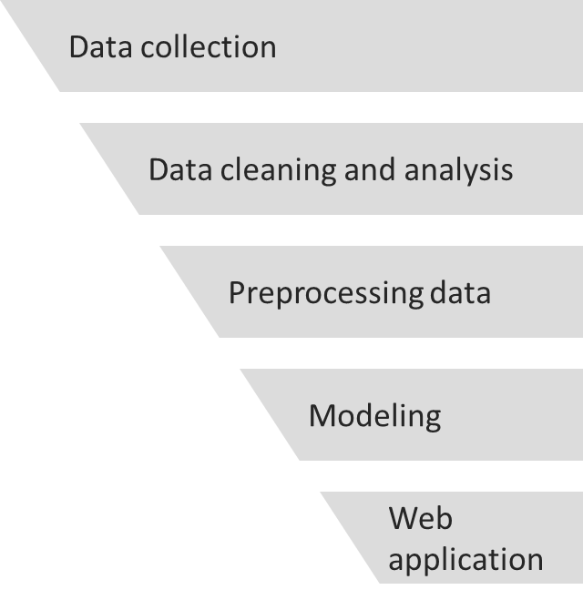
Steps to create fake news detection model

Slide 4
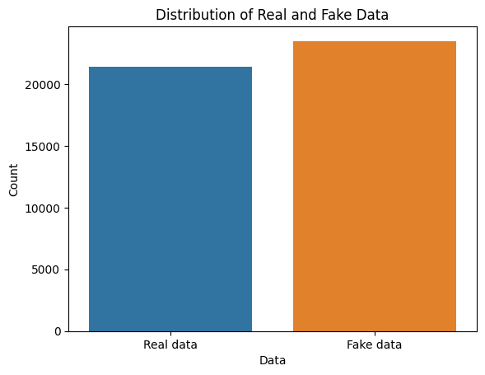
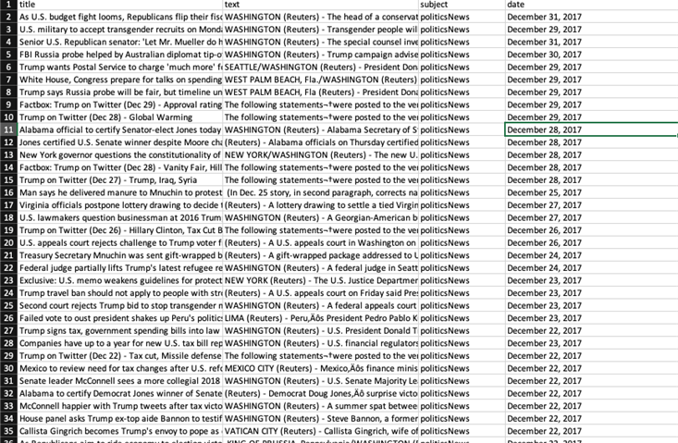
Data Collection & Analysis
Dataset
Real data - 21,417 rows
Fake data - 23,481 rows

Slide 5
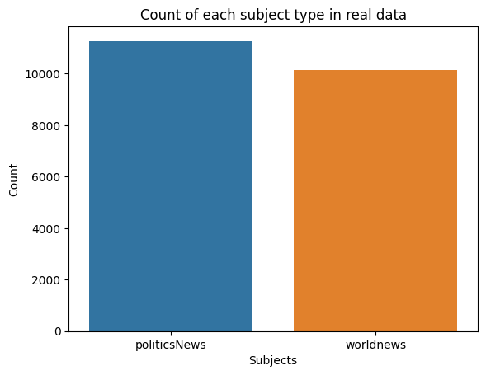
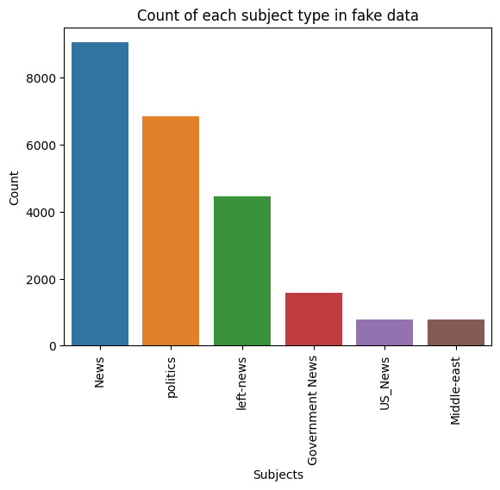
Data Collection & Analysis

Slide 6
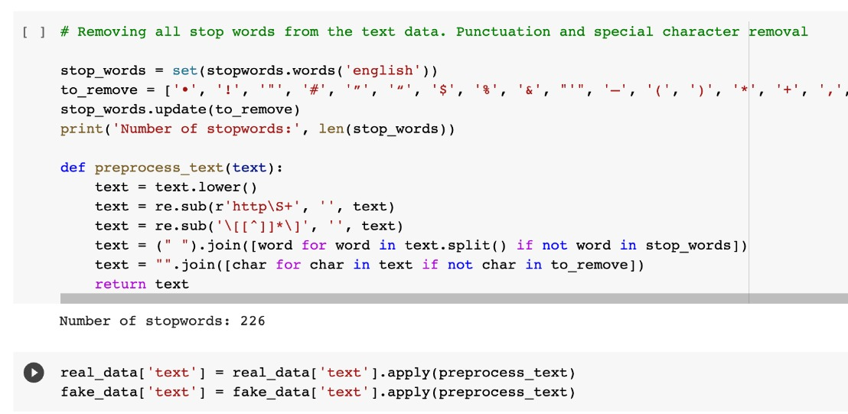
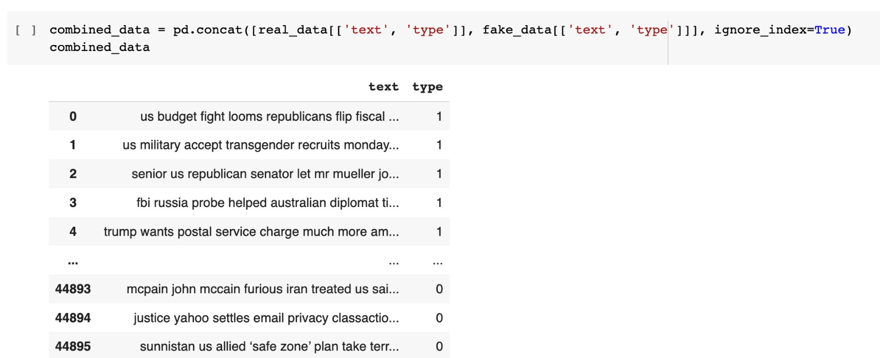
Data Cleaning & Pre-processing
Null values in the data set.
Patterns found in raw data
Stop word removal
Combining of both data sets
Introducing label in the data to classify the data.
Decision on what features/ columns of data to choose for training and testing the model

Slide 7


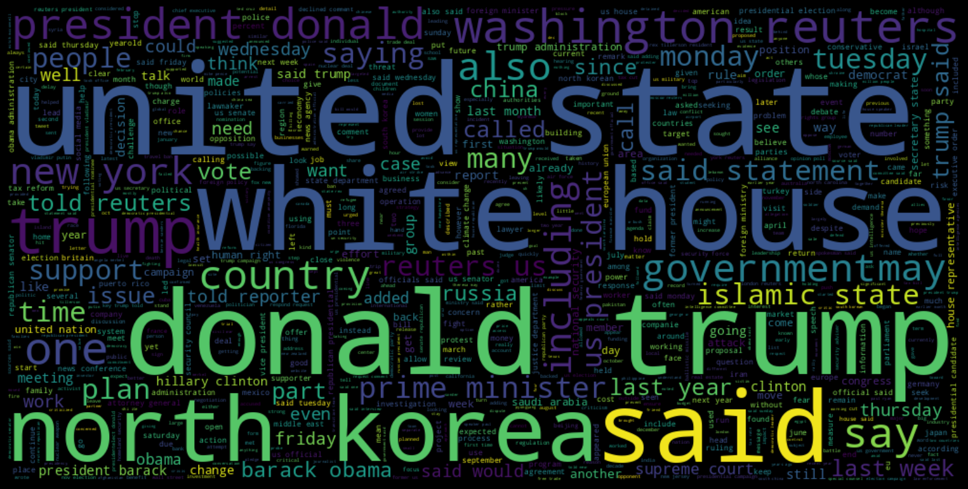
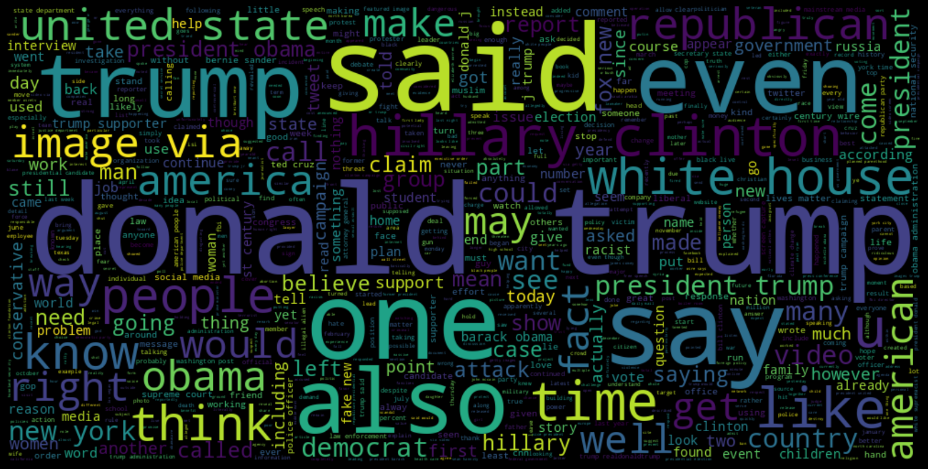
WordCloud

Slide 8
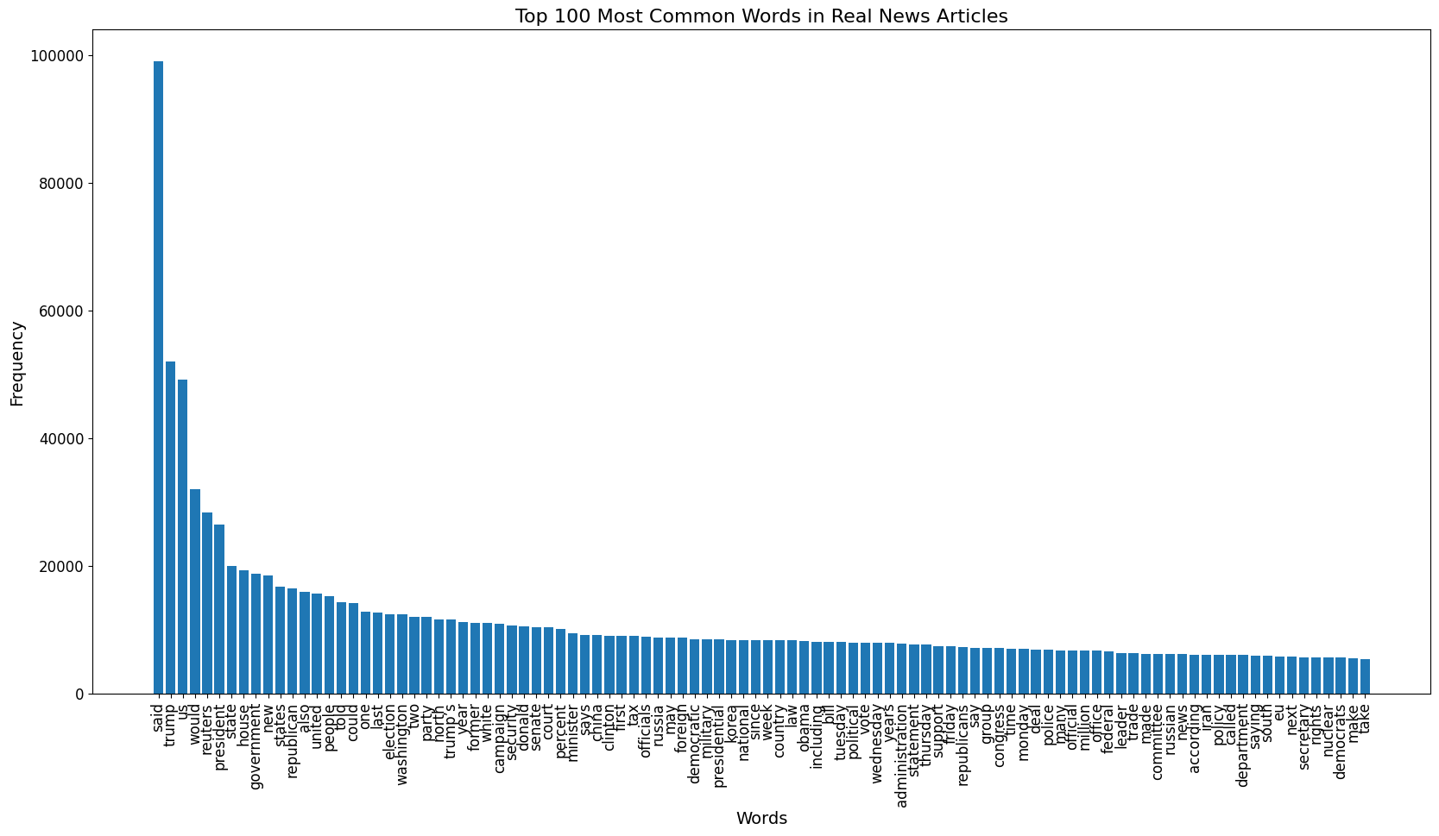
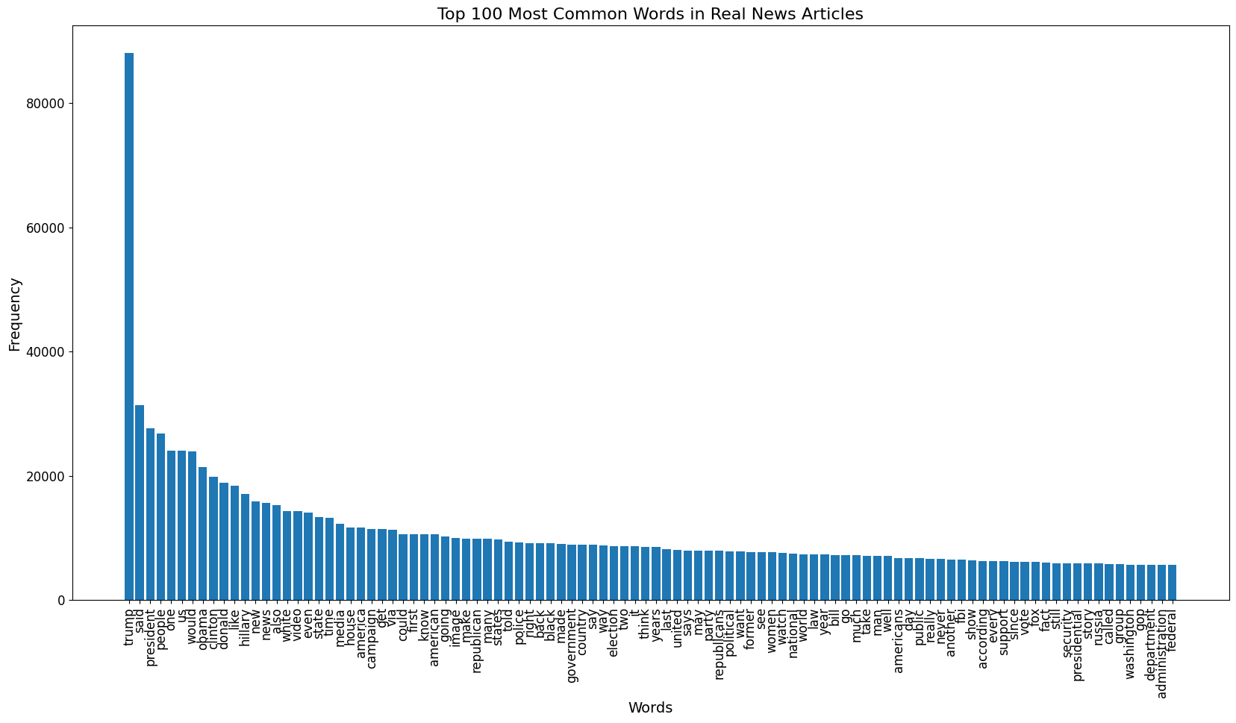
Most common words
Top 100 Most common Words in Real and Fake News Articles

Slide 9
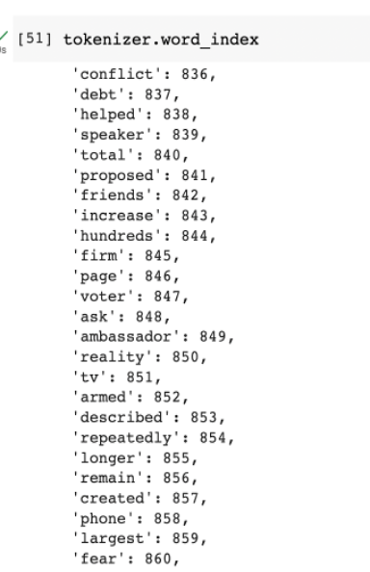
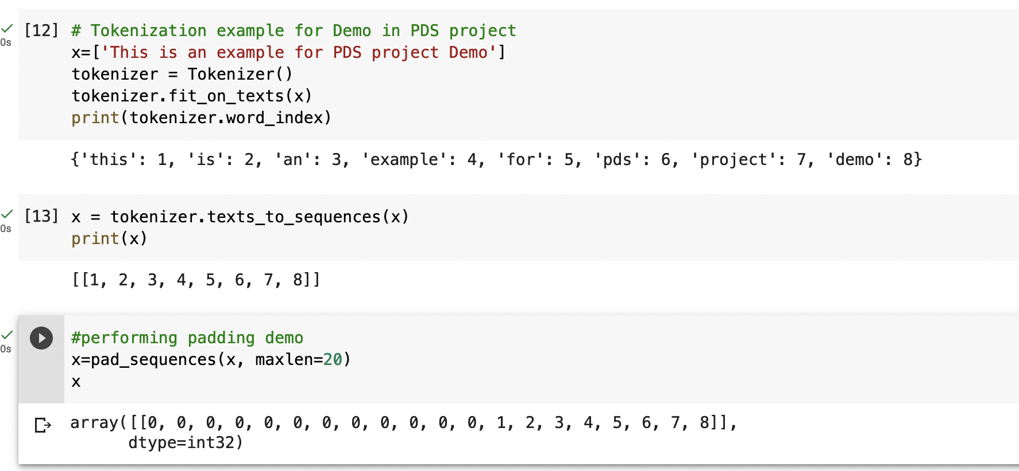
Modeling preprocess steps
One of the most important steps before modeling while working with text type of data is Tokenization.
Never give up → never-give-up (Tokenization)
After converting into token, the next important step is to perform padding on the tokenized sequences to ensure that all the sequences have the same length before loading into the model.

Slide 10
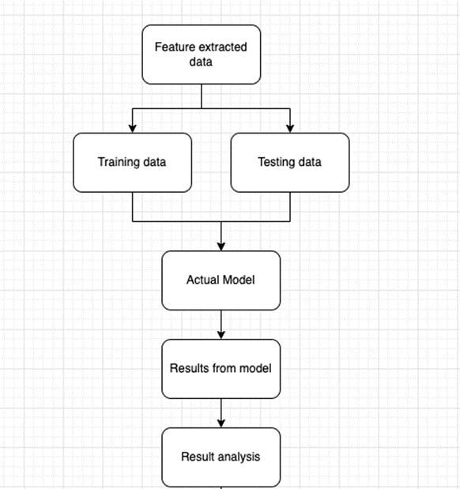
Modeling
After getting the tokenized data, it will be given as an input for modelling.
Initially we performed some comparative analysis using some modelling techniques and we came up with Sequential modelling.
In the model we have used LSTM networks to capture long-term dependencies in text data.

Slide 11
Model Testing
70-30 training and testing data split on feature extracted data.
We are using a reliable source to test our model for fake news detection.
We are getting an accuracy of 94.24%.
To test some samples, we developed a function that used to perform prediction on the input data.
To test our model, we can make up news that we know is fake and use it as a predictor.

Slide 12
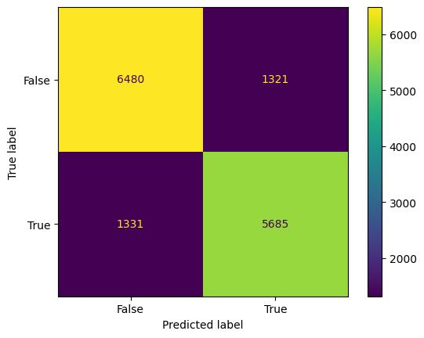
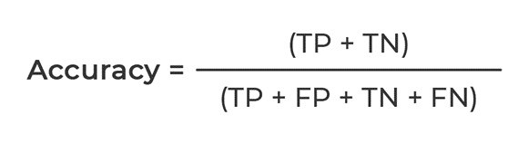
Results
Confusion matrix
Training and testing accuracy
Since this is a binary classification, we use accuracy as the main metric.

Slide 13
Analysis of Results
We see that our model is performing with a good accuracy and is accurately predicting real and fake news.
False positive and False negative values are also not very high, which means our model is effectively training and is able classify data correctly.
But we are still able to find some misclassification which can be eliminated.

Slide 14
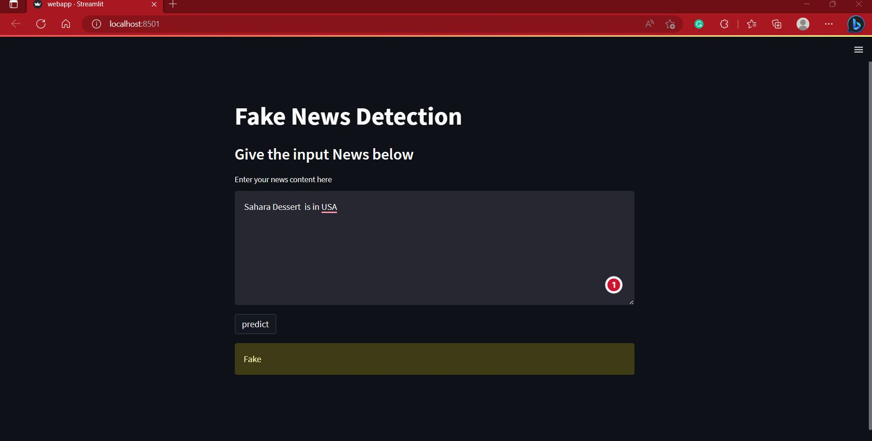
Developing Web Application
We developed web application by using Streamlit
Streamlit is open-source app framework
By using Streamlit, we can build app by writing few lengths of code
It is python based library, specifically designed for machine learning

Slide 15
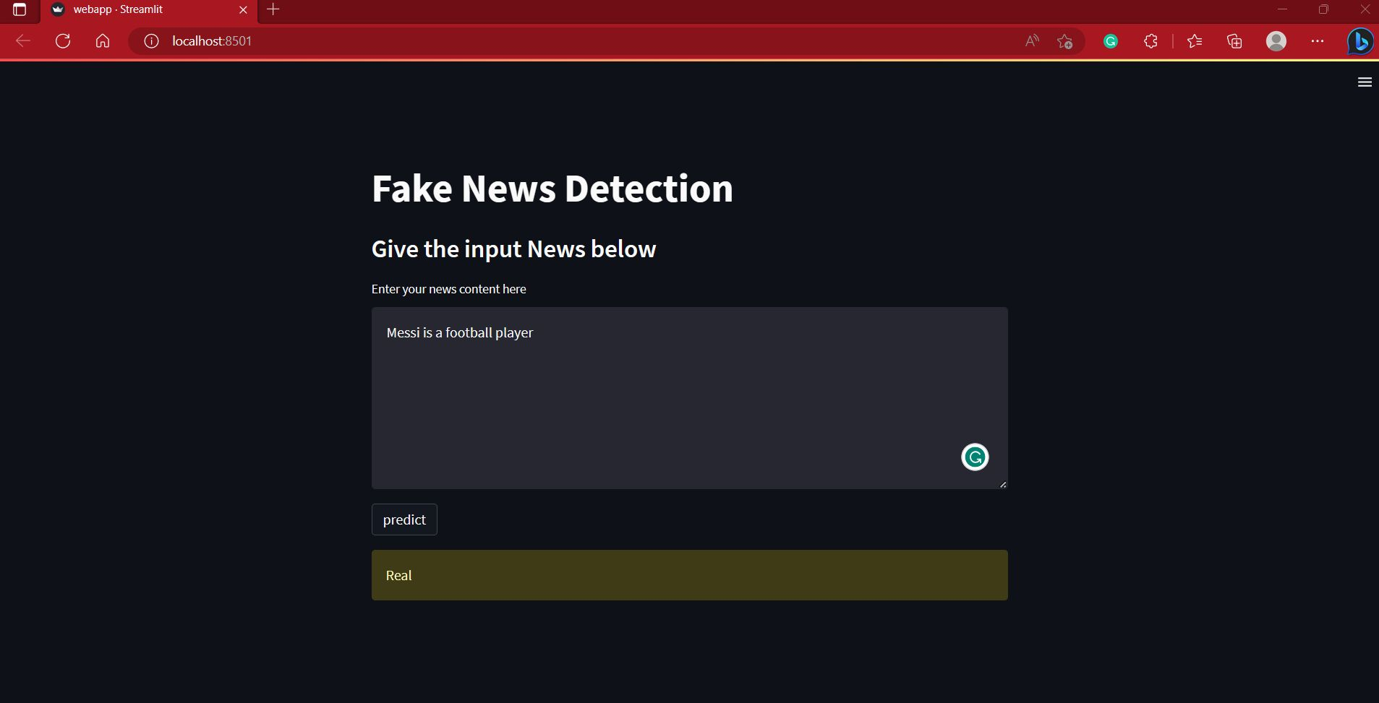
Developing Web Application

Slide 16

Demo of Application

Slide 17
Future Enhancement
Dataset Enhancement (Our dataset is based US news)
Model Enhancement
Application Enhancement

Slide 18
Thank You

